Slide 1
movie Recommendation System Written in python By-Data_miners

Slide 2

Introduction
We tend to like things that are similar to other things we like
We tend to like things that similar people like
These patterns can be used to make predictions to offer new things

Slide 3
What is a recommender system?
A recommender system is a simple algorithm whose aim is to provide the most relevant information to a user by discovering patterns in a dataset. The algorithm rates the items and shows the user the items that they would rate highly. An example of recommendation in action is when you visit Amazon and you notice that some items are being recommended to you or when Netflix recommends certain movies to you. They are also used by Music streaming applications such as Spotify and Deezer to recommend music that you might like.

Slide 4
Movie Recommendation System
Content Based: The recommendation system recommends other movies which are similar to that selected movie.
f(movie) → {movies}
2. Collaborative: The recommendation system recommends movies which are rated highly by the similar users.
f(movies, user) → {movies}

Slide 5
.
Recommendation systems involve predicting user preferences for unseen items such as movies, songs or books
Recommendation systems have become very popular with the increasing availability of millions of products online
Recommending relevant products increases the sales

Slide 6

Dataset
Geeksforgeeks.org 100K dataset
100,000 ratings (1-5) from 943 users on 1664 movies
At least 20 movies for each user

Slide 7
PLATFORM & LIBRARIES USE IN PROJECT
Instead of using traditional PYTHON Notebooks (Jupyter notebook) example we use Kaggle.com so that we can write different part of code at a time to manage time & we all can edit a single notebook at same time.
Libraries-
Numpy:-NumPy is a python library used for working with arrays. It also has functions for working in domain of linear algebra, fourier transform, and matrices
Pandas:- Pandas is a high-level data manipulation tool developed by Wes McKinney. It is built on the Numpy package and its key data structure is called the DataFrame.
Matplotlib:- matplotlib. pyplot is a collection of command style functions that make matplotlib work like MATLAB. Each pyplot function makes some change to a figure: e.g., creates a figure, creates a plotting area in a figure, plots some lines in a plotting area, decorates the plot with labels, etc.
CSV:-Python provides a CSV module to handle CSV files. To read/write data, you need to loop through rows of the CSV.

Slide 8
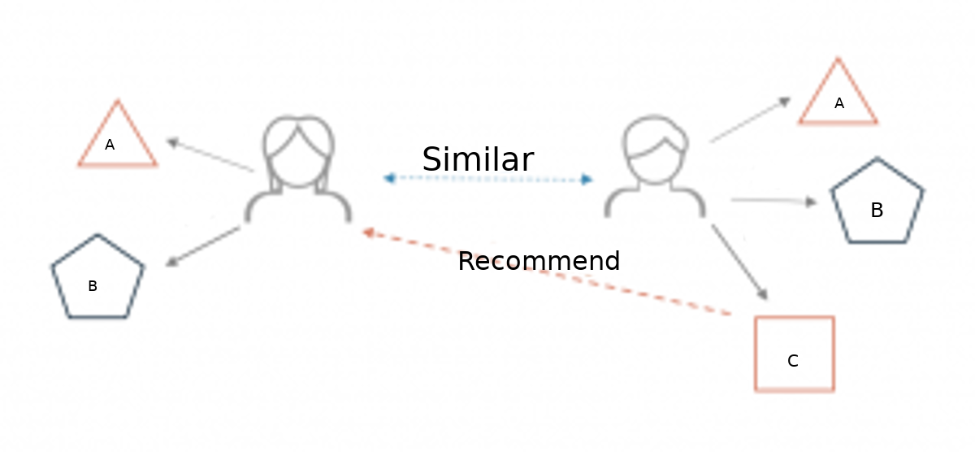
Below is a very simple illustration of how recommender systems work in the context of an e-commerce site.

Slide 9
Methodology
Collaborative
Recommend items those are preferred by similar users.
Content-based
Recommend items based on similarity between items and user's preferences.

Slide 10
Walkthrough of building a MOVIE recommender system

Slide 11
DATA PRE-PROCESSING steps
STEP:-1 import basic lib. and data base which we have to use.
STEP:-2 check the head of the data
Step:-3 Checking out all the movies and there respective IDs
Step:-4 Calculating mean rating of all movies
Step:-5 Calculate count rating of all movies
Step:-6 Creating dataframe with ‘rating’ count values
Step:-7 import Matplotlib.pyplot
Step:-8 Plot a graph of ‘num of ratings column’
Step:-9 Plot a graph of ‘ratings’ column
Step:-10 sort values according to the ‘num of rating column’
Step:-11 Analysing correlation with similar movies

Slide 12
We are going to use the Kaggle.com to build a simple item similarity-based recommender system. The first thing we need to do is to import pandas and numpy.
STEP-1&
STEP-2
# these lines is taken from code:- import pandas as pd import numpy as np
Next, we load in the data set using pandas read_csv() utility. The dataset is tab separated so we pass in \t to the sep parameter. We then pass in the column names using the names parameter.

Slide 13
column_names = ['user_id', 'item_id', 'rating', 'timestamp'] path = '../input/movie-recimendation/file.tsv' df = pd.read_csv(path, sep='\t', names=column_names) # Check the head of the data df.head()
STEP-3
It would be nice if we can see the titles of the movie instead of just dealing with the IDs. Let’s load in the movie titles and merge it with this dataset.
movie_titles = pd.read_csv('../input/movie-recimendation/Movie_Id_Titles.csv') movie_titles.head()

Slide 14
Let’s look at what each column represents:
user_id - the ID of the user who rated the movie.
item_id - the ID of the movie.
rating - The rating the user gave the movie, between 1 and 5.
timestamp - The time the movie was rated.
title - The title of the movie.
Using the describe or info commands we can get a brief description of our dataset. This is important in order to enable us to understand the dataset we are working with.

Slide 15
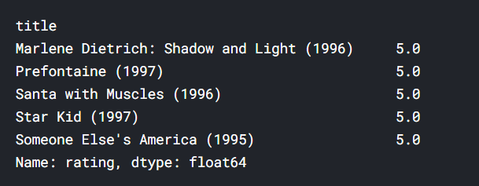
# Calculate mean rating of all movies data.groupby('title')['rating'].mean().sort_values(ascending=False).head()
STEP-4&
STEP-5
# Calculate count rating of all movies data.groupby('title')['rating'].count().sort_values(ascending=False).head() step 5 output on next slide.

Slide 16
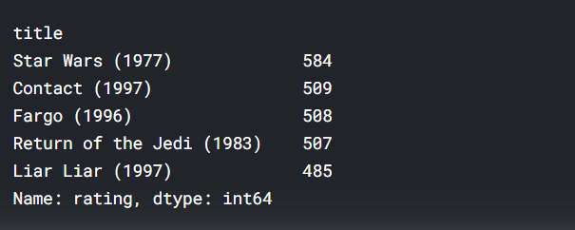
STEP-6
Here,we know that the average rating per movie and the number of ratings per movie both are important attributes.
# creating dataframe with 'rating' count values ratings = pd.DataFrame(data.groupby('title')['rating'].mean()) ratings['num of ratings'] = pd.DataFrame(data.groupby('title')['rating'].count()) ratings.head() output on next page

Slide 17
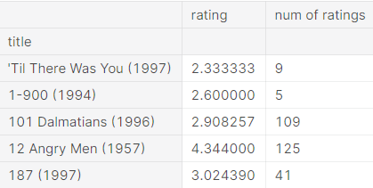

Slide 18
Let’s now plot a Histogram using pandas plotting functionality to visualize the distribution of the ratings
import matplotlib.pyplot as plt %matplotlib inline ratings['rating'].hist(bins=50)
We can see that most of the movies are rated between 2.5 and 4. Next, let’s visualize the number_of_ratings column in as similar manner.
HISTOGRAM IS ON NEXT PAGE
STEP-7
# plot graph of 'ratings' column plt.figure(figsize =(10, 4)) ratings['rating'].hist(bins = 70)

Slide 19
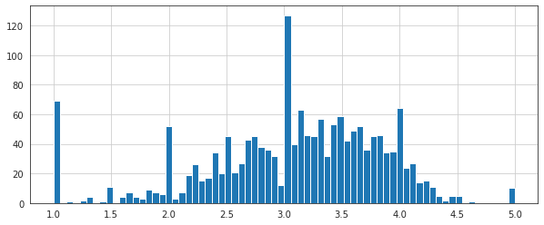
Here We can see, Most of the users assign rating as integer value like 1, 2, 3, 4 or 5. it is evident that the data has a weak normal distribution with the mean of around 3.0.

Slide 20
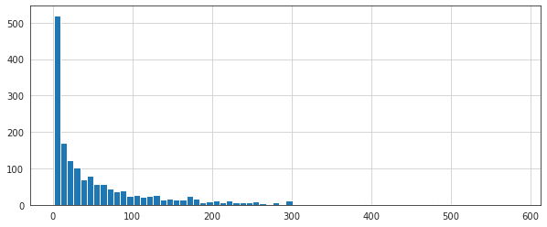
# plot graph of 'num of ratings column’ plt.figure(figsize =(10, 4)) ratings['num of ratings'].hist(bins = 70)
STEP-9
Here, We see that most of the movies have received less than 50 ratings. While the number of movies having more than 100 ratings is very low.

Slide 21
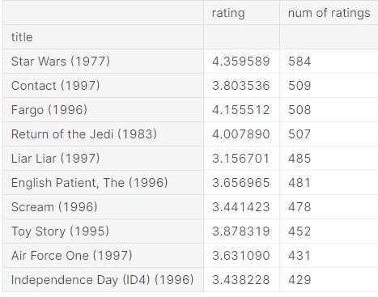
# Sorting values according to # the 'num of rating column’ moviemat = data.pivot_table(index ='user_id’, columns ='title', values ='rating’) moviemat.head() ratings.sort_values('num of ratings', ascending = False). head(10)
STEP-10
Filter movies correlated to "Star Wars (1977)", that have more than 584 ratings.

Slide 22
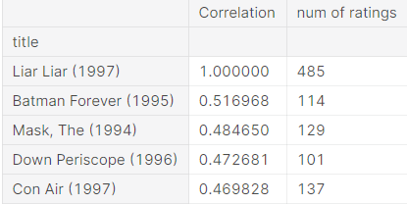
# Similar movies as of liarliar corr_liarliar = pd.DataFrame(similar_to_liarliar, columns =['Correlation']) corr_liarliar.dropna(inplace = True) corr_liarliar = corr_liarliar.join(ratings['num of ratings']) corr_liarliar[corr_liarliar['num of ratings']>100].sort_values('Correlation', ascending = False).head()
STEP-11

Slide 23

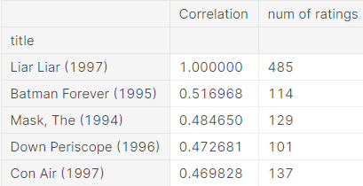
CONCLUSION
The output the movies that are highly correlated with "liar liar (1997)". The movies in the list are some of the most famous movies .and "Liar Liar (1997)" is also a very famous movie.

Slide 24
QUERIES
THANK YOU
FOR BEING WITH US

